Slide 1

Artificial Intelligence for Business Decisions and Transformation
CSCN8030 - Spring 2024 - Section 2
Sprint 6 - Demo
August 12, 2024
Group 4 - Members:
Krishna Kumar, Hemasree
Shijin, Jency
Fernandez, Arcadio
Professor:
Glaucia Melo dos Santos, PhD

Slide 2

Our focus
1. Optimizing Group Fitness Class Utilization
Objective: Increase the number of available spaces for fitness classes by predicting member attendance and reallocating spaces from predicted absences.
Techniques: Predictive modeling, Logistic regression, Decision trees, Random Forest
Outcome: Higher utilization rate of fitness class spaces, reduced class wait times, and improved member satisfaction due to better space management
2. Optimizing Gym Equipment Utilization
Objective: Estimate the number of people using the gym at different times of day to maximize equipment availability and promote use.
Techniques: Feature selection techniques, Feature engineering, predictive analytics, Regression techniques
Outcome: Accurate predictions of gym crowd levels, which allows for better scheduling and improved equipment availability during peak times.

Slide 3
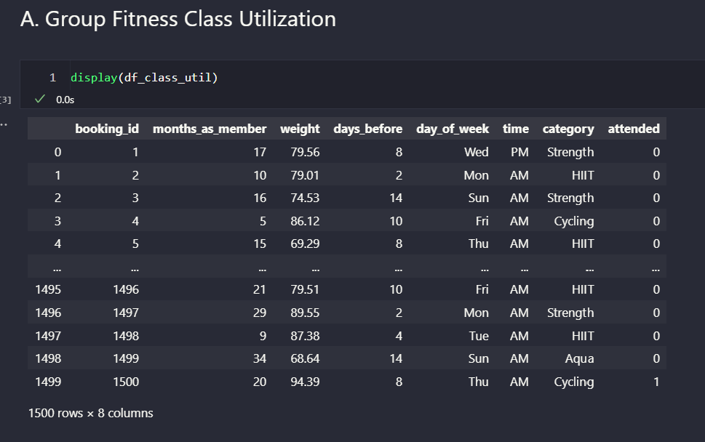
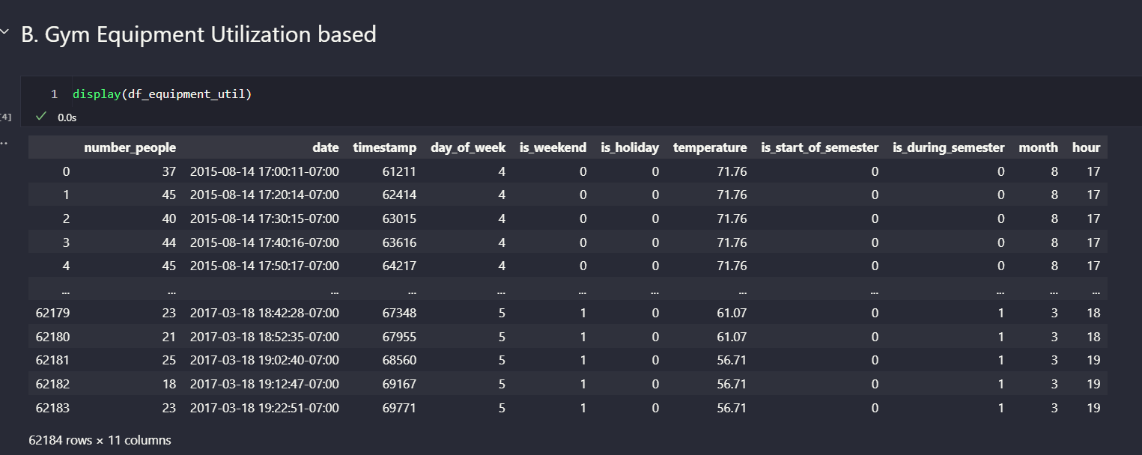
Data

Slide 4

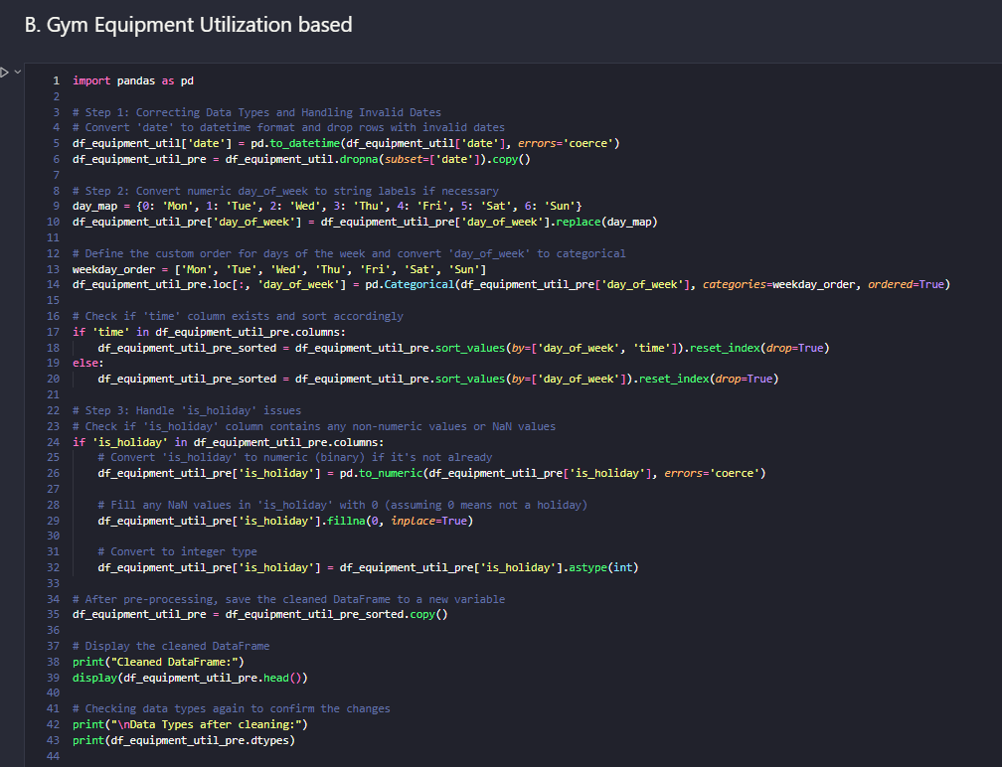
2. Clean the data by handling missing values, correcting data types, and ensuring data consistency.

Slide 5
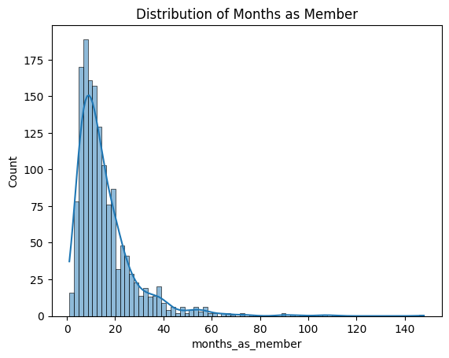
3. Exploratory Data Analysis
The graph shows a right-skewed distribution of gym membership duration, with most members staying for a short period, peaking in the first few months. A small number of long-term members create a long tail extending up to 140 months. This suggests a high turnover rate and a smaller group of dedicated members. Understanding this distribution can inform predictive models for optimizing class attendance and gym equipment utilization.

Slide 6
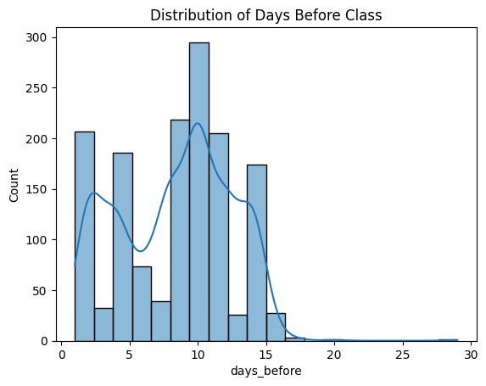
3. Exploratory Data Analysis
The graph shows the distribution of how many days before a class members typically register. Most registrations occur between 5 to 15 days before the class, peaking around 10 days. There's a noticeable drop in registrations after 15 days, and very few members register more than 20 days in advance. This pattern indicates that members tend to plan their class attendance about 1-2 weeks ahead.

Slide 7
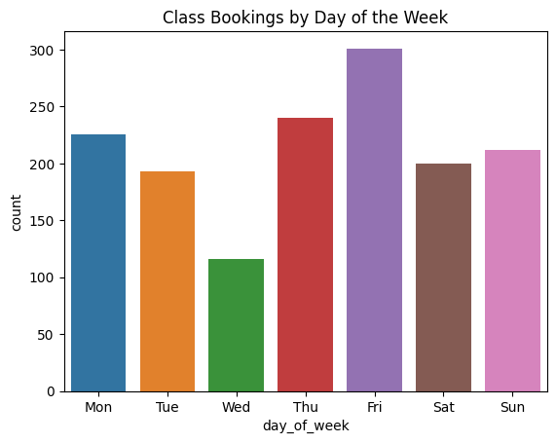
3. Exploratory Data Analysis
The graph shows class bookings by the day of the week, with Friday being the most popular day for bookings, followed by Thursday and Monday. Wednesday has the fewest bookings, indicating a mid-week dip in class attendance. The pattern suggests that members prefer to book classes towards the end of the workweek, with consistent attendance on weekends as well. This insight can help in scheduling classes to match peak demand times.

Slide 8
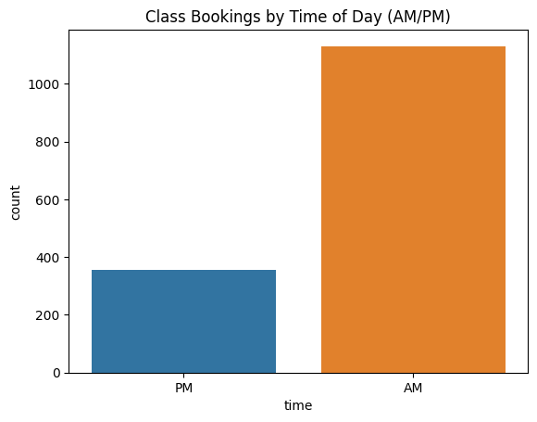
3. Exploratory Data Analysis
The graph indicates that most class bookings occur in the morning (AM) compared to the afternoon or evening (PM). This suggests that members prefer to attend classes earlier in the day. Understanding this preference can help in scheduling more classes in the morning to meet member demand and optimize class attendance.

Slide 9
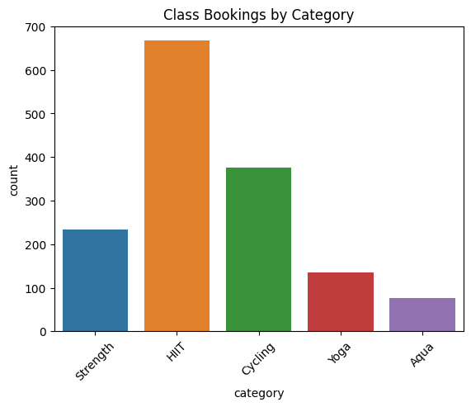
3. Exploratory Data Analysis
The graph shows that High-Intensity Interval Training (HIIT) is the most popular class category, followed by Cycling. Strength, Yoga, and Aqua classes have significantly fewer bookings. This indicates that members have a strong preference for high-intensity and cardio-focused classes. Understanding these preferences can help GoodLife Fitness optimize their class offerings and schedule more sessions for the most popular categories.

Slide 10
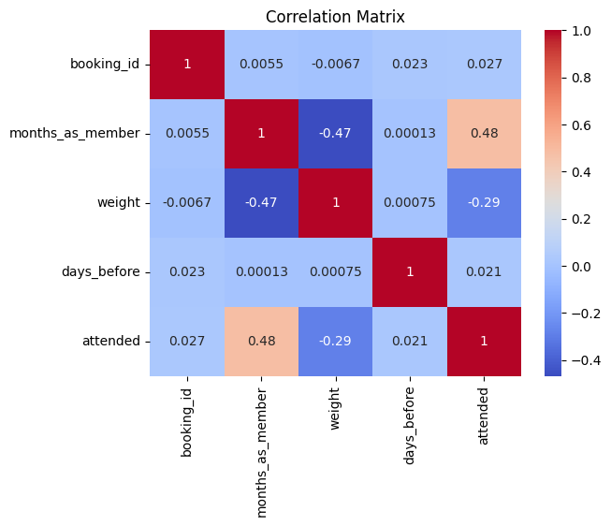
3. Exploratory Data Analysis
The correlation matrix shows the relationships between different features related to class attendance. Notably, months_as_member has a moderate positive correlation (0.48) with attended, indicating that longer-term members are more likely to attend classes. Conversely, weight has a moderate negative correlation (-0.29) with attended, suggesting that as weight increases, the likelihood of attending decreases. Other features, like days_before, show minimal correlation with attendance, indicating they might not significantly influence whether a member attends a class. This matrix helps in understanding which factors are more influential in predicting class attendance.

Slide 11
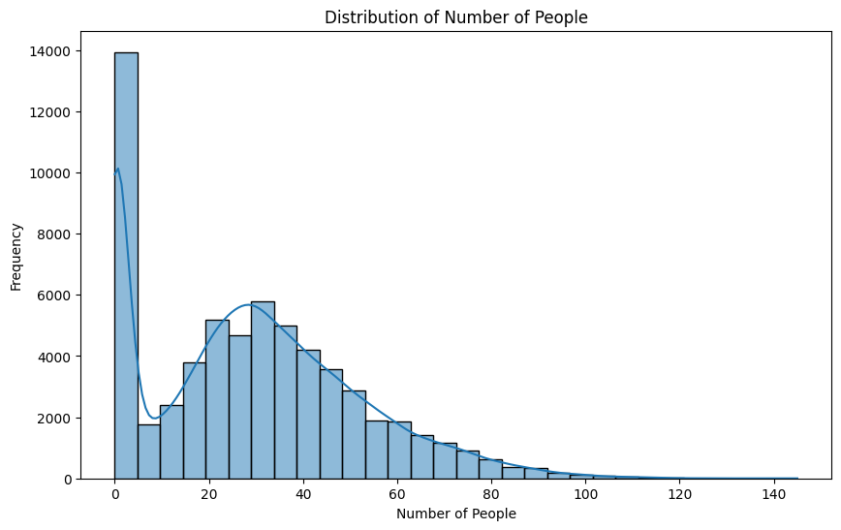
3. Exploratory Data Analysis
The graph displays the distribution of the number of people in the gym at various times, showing a right-skewed pattern. Most of the time, the gym is relatively empty, with a large frequency of instances where the number of people is very low. As the number of people increases, the frequency decreases, with a gradual decline as the gym becomes more crowded. The peak around low numbers of people suggests that the gym often has minimal occupancy, while higher crowd levels are less common. This distribution can help in predicting and managing crowd levels to improve gym utilization.

Slide 12
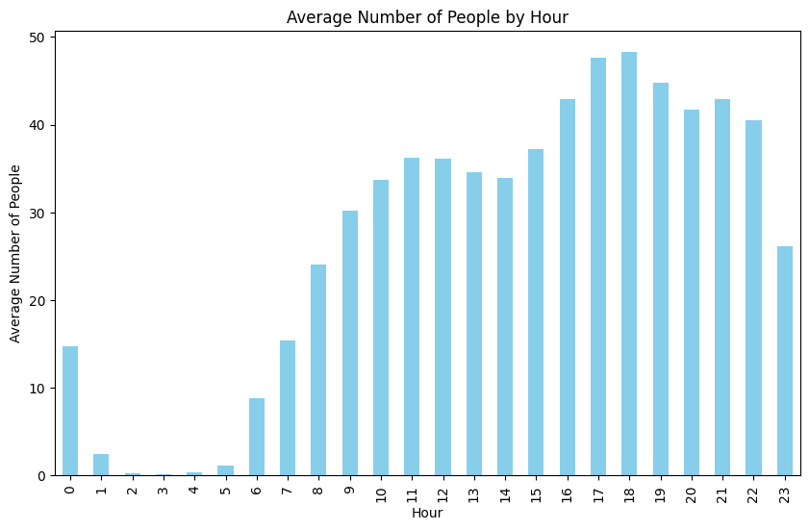
3. Exploratory Data Analysis
The graph shows the average number of people in the gym by hour of the day. The gym starts to get busier from around 6 AM, peaking between 5 PM and 6 PM, likely due to people attending after work. There’s a gradual decline in occupancy after 6 PM, with a notable drop late at night. This pattern highlights peak hours in the early morning and late afternoon to early evening, suggesting these are the busiest times for gym usage, which can inform staffing and equipment allocation decisions.

Slide 13
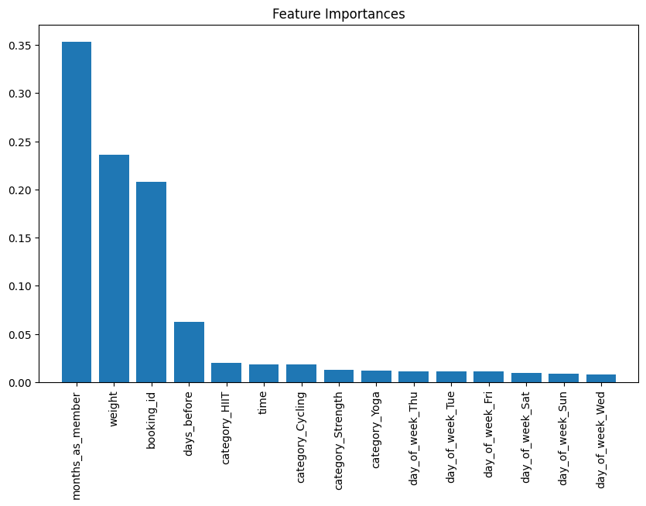
4. Feature Analysis
### 6.A. Group Class utilization dataset
### Variance Inflation Factor for Checking Multicollinearity between features
* booking_id (3.902744): Low VIF, indicating no significant multicollinearity for this feature.
* months_as_member (2.383969): Low VIF, suggesting no significant multicollinearity.
* weight (20.011770): High VIF, indicating severe multicollinearity. This feature is highly correlated with other features, which could be problematic.
* days_before (129.887587): Very high VIF, indicating extreme multicollinearity. This feature is likely to be highly correlated with other predictors.
* time (1.602183): Low VIF, indicating no significant multicollinearity.
* day_of_week_* (day_of_week_Tue - 2.667748): Low to moderate VIFs, suggesting that these features are not highly collinear individually.
* category_* (category_Cycling - 5.059412): Moderate VIFs, indicating that some collinearity might be present but not extreme.

Slide 14
4. Feature Analysis
### 6.B. Group Gym Equipment utilization dataset
### Correlation and Chi-square Test
* High P-Values (1.0): Features like day_of_week, is_weekend, is_holiday, and is_during_semester are not significantly associated with the target variable and might be redundant. Consider removing them.
* Moderate P-Values: is_start_of_semester (0.0628) and month (0.0851) show some association but are not statistically significant. They might still be useful, so consider further analysis.
* Low P-Value: date had a high p-value (0.4878), indicating it doesn’t provide useful information directly. Extract specific components like year, month, and day for better analysis.
number_people 1.000000 timestamp 0.550218 is_weekend -0.173958 is_holiday -0.048249 temperature 0.373327 is_start_of_semester 0.182683 is_during_semester 0.335350 month -0.097854 hour 0.552049 Name: number_people, dtype: float64

Slide 15
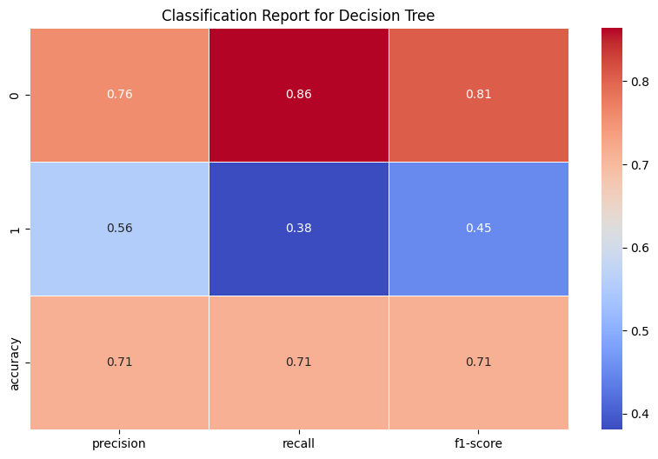
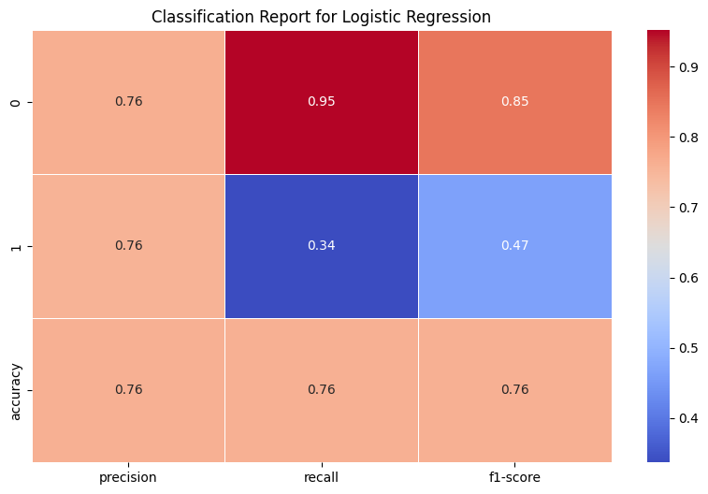
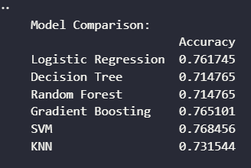
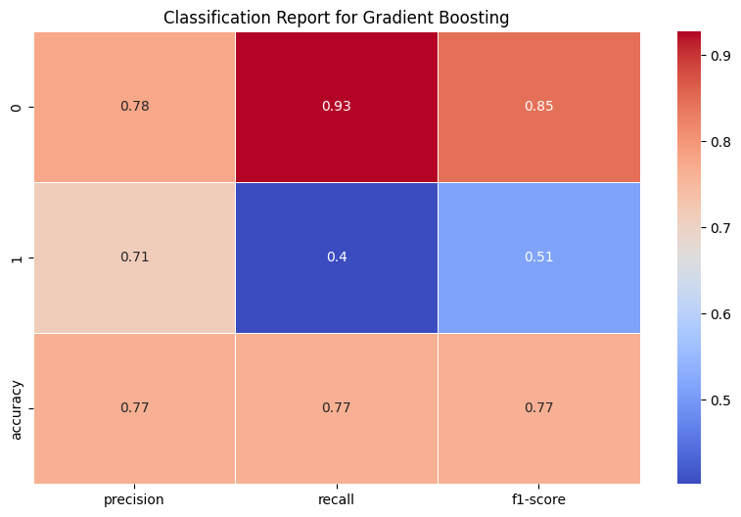
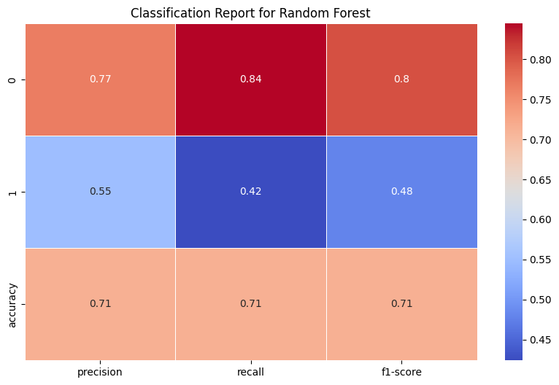
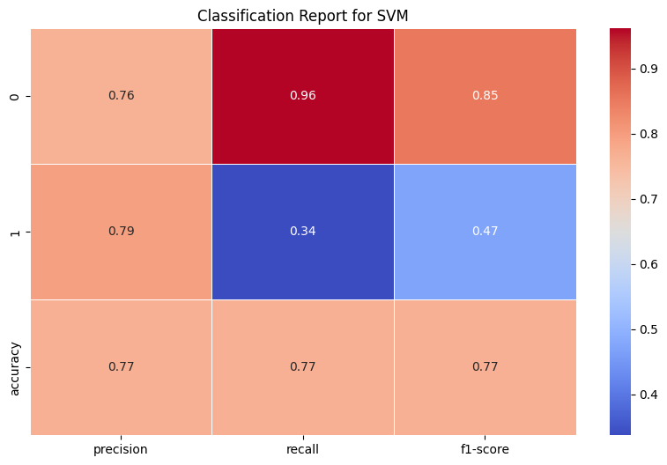
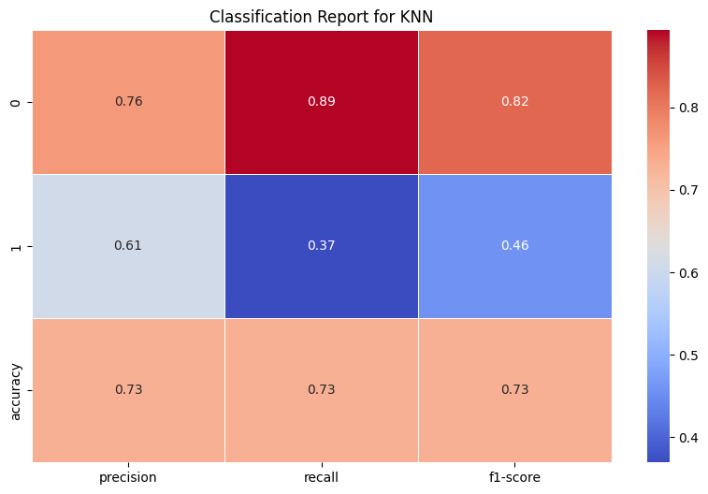
5. Choose appropriate machine learning algorithms
### 8.A. Group Class utilization dataset
The table above shows that the SVM model has the highest accuracy, followed by the Gradient Boosting and Logistic Regression models.

Slide 16
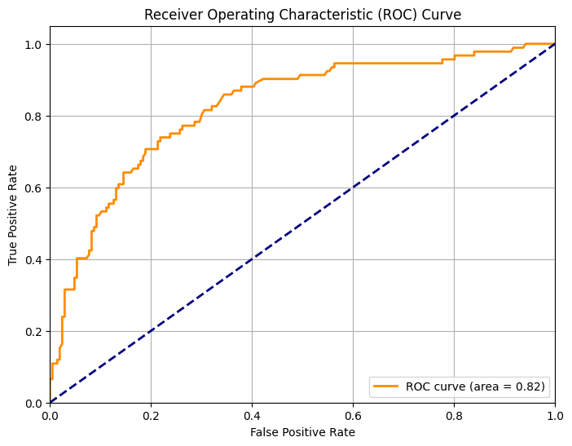
5. Choose appropriate machine learning algorithms
### 8.A. Group Class utilization dataset
The graph is a Receiver Operating Characteristic (ROC) curve generated for an SVM classifier model. It plots the True Positive Rate (TPR) against the False Positive Rate (FPR) at various threshold settings. The Area Under the Curve (AUC) is 0.82, indicating that the model has good discriminatory power. The model was tuned using GridSearchCV, and the ROC curve reflects the performance of the best model, which was trained with a linear kernel and optimized regularization parameter. The curve shows that the model is better than random guessing (which would have an AUC of 0.5).

Slide 17
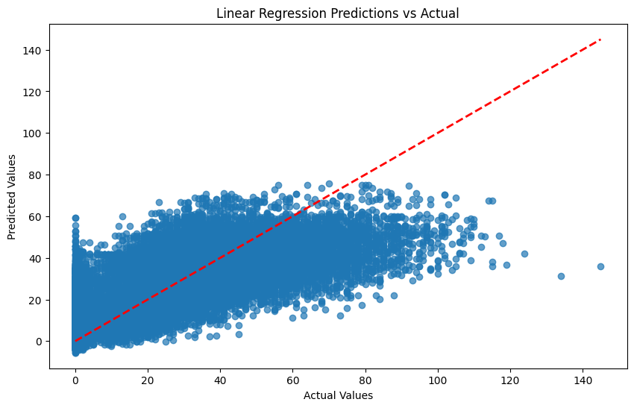
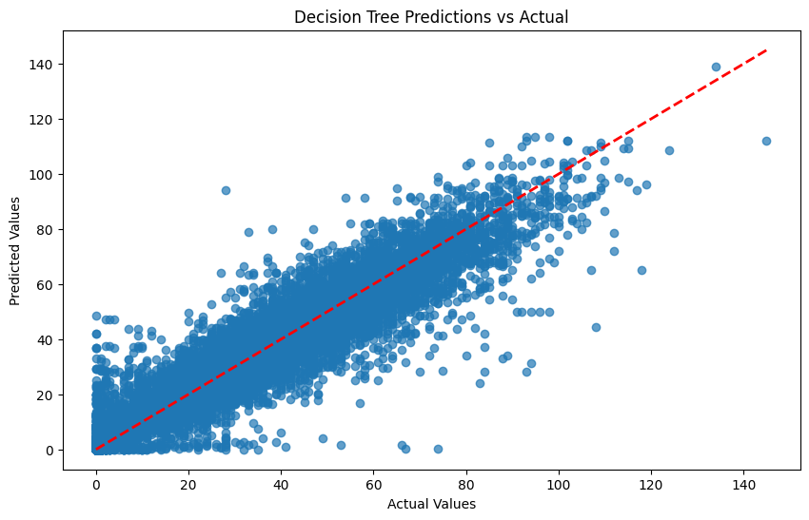
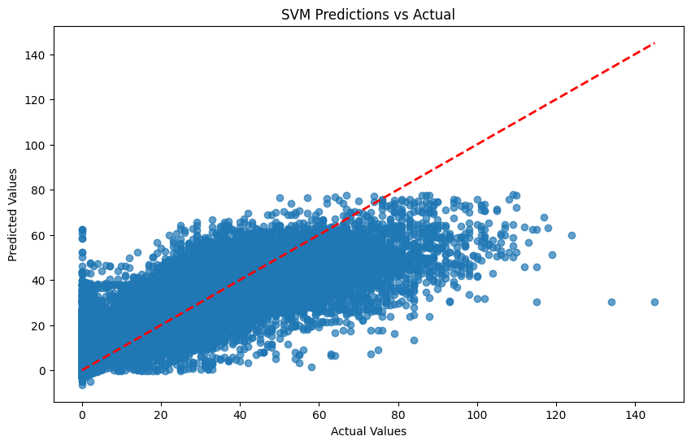
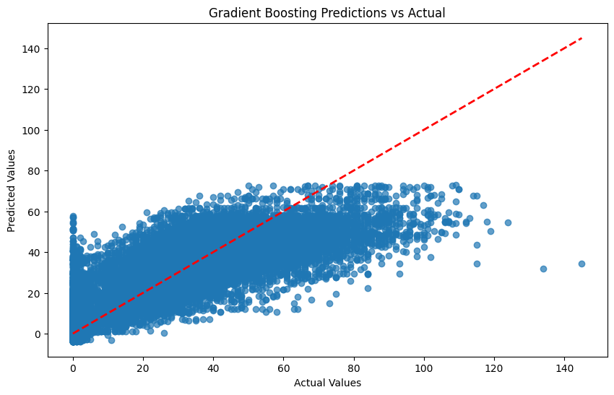
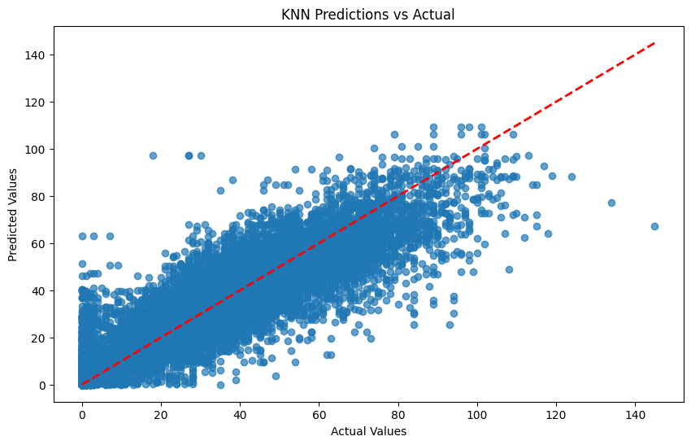
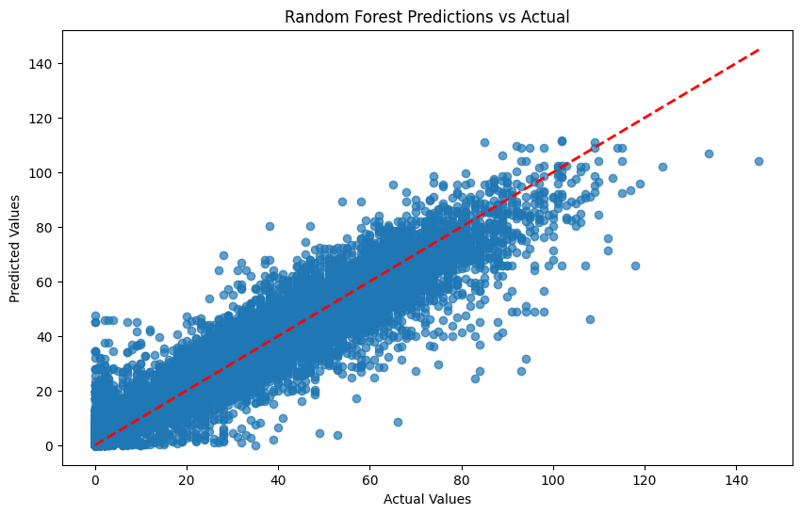
5. Choose appropriate machine learning algorithms
8.B. Group Gym Equipment utilization dataset

Slide 18
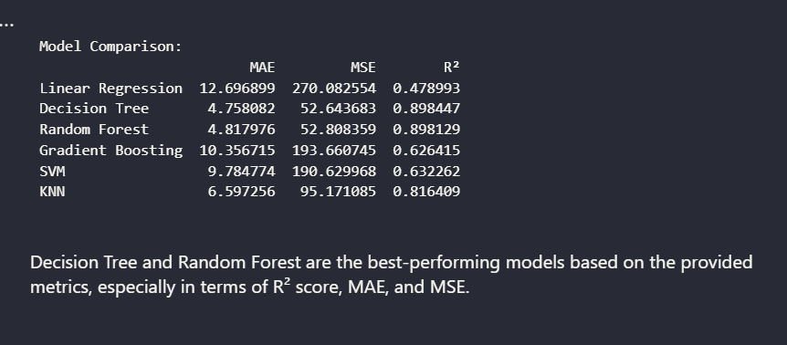
5. Choose appropriate machine learning algorithms
8.B. Group Gym Equipment utilization dataset
The graphs and metrics evaluate different machine learning models for predicting gym equipment utilization. Both the Random Forest and Decision Tree models show strong accuracy, with predictions closely matching actual values. These models also have the lowest errors (MAE and MSE) and highest R2R^2R2 scores, indicating they are the most effective for this task. This analysis suggests that these models are best suited for optimizing gym equipment usage predictions, helping to improve operational efficiency.

